Slide 1
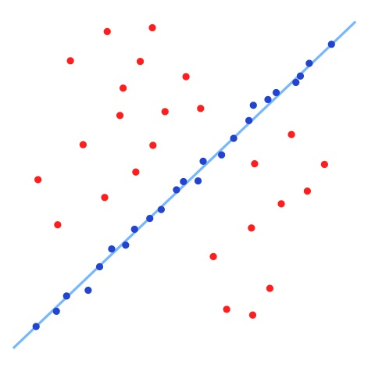
Fitting and Alignment
Computer Vision
Jia-Bin Huang, Virginia Tech
Many slides from S. Lazebnik and D. Hoiem

Slide 2
Administrative Stuffs
HW 1
Competition: Edge Detection
Submission link
HW 2 will be posted tonight
Due Oct 3

Slide 3
Anonymous feedback
Post PDF slides

Slide 4
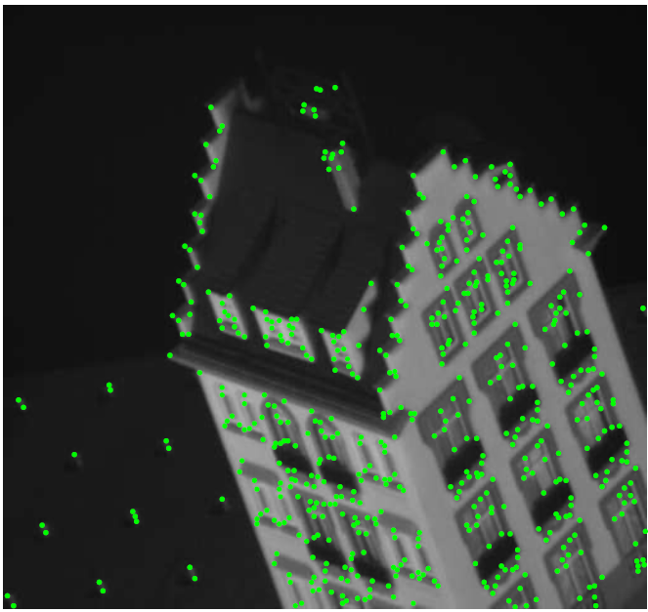
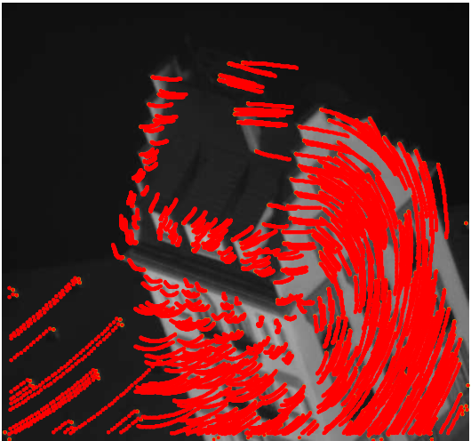
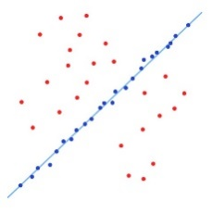
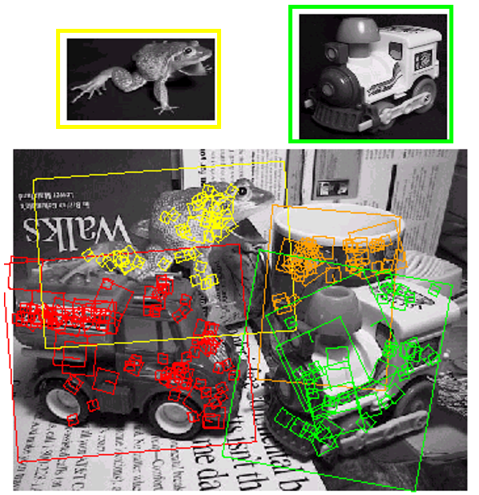
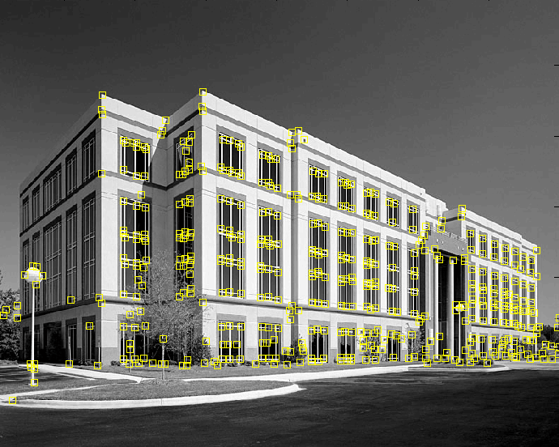
Where are we?
Interest points
Find distinct and repeatable points in images
Harris-> corners, DoG -> blobs
SIFT -> feature descriptor
Feature tracking and optical flow
Find motion of a keypoint/pixel over time
Lucas-Kanade:
brightness consistency, small motion, spatial coherence
Handle large motion:
iterative update + pyramid search
Fitting and alignment (this class)
Find the transformation parameters that best align matched points
Object instance recognition (next class)
Keypoint-based object instance recognition and search

Slide 5
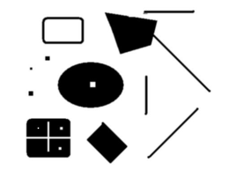
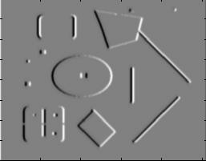
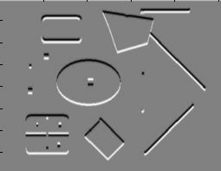
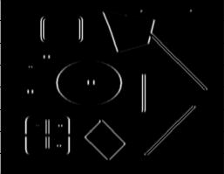
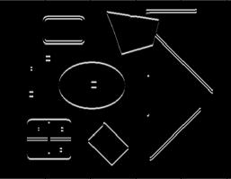
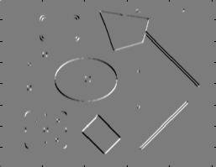
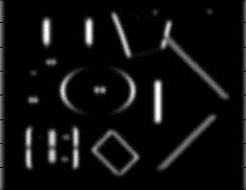
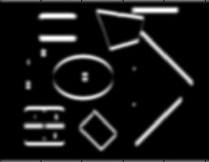
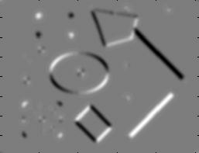
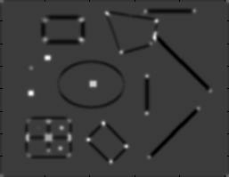
Review: Harris Corner Detector
Second moment matrix
1. Image derivatives
I_{x}
I_{y}
(optionally, blur first)
I_{x}²
I_{y}²
I_{x}I_{y}
2. Square of derivatives
3. Gaussian filter g(σ_{I})
g(I_{x}²)
g(I_{y}²)
g(I_{x}I_{y})
4. Cornerness function – both eigenvalues are strong
5. Non-maxima suppression
har

Slide 6
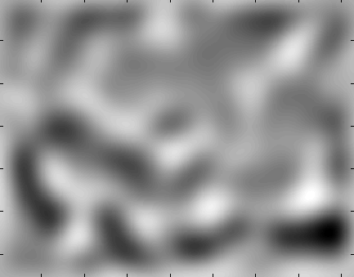
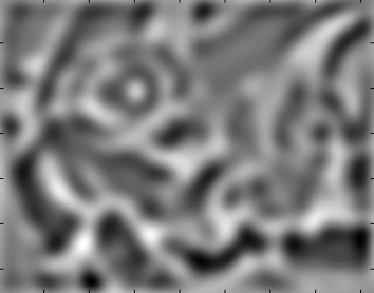
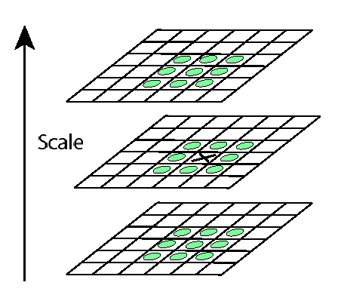
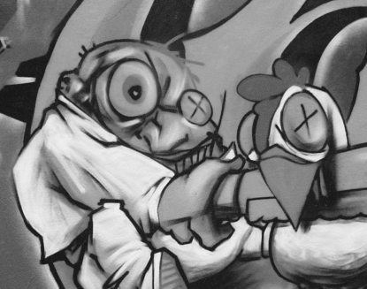
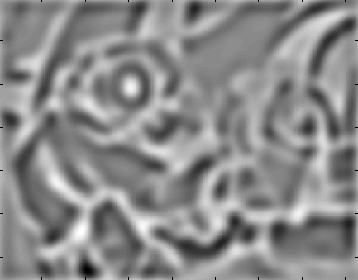
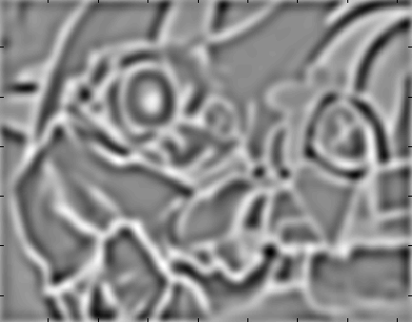
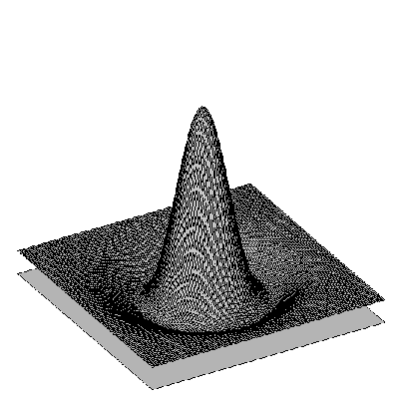
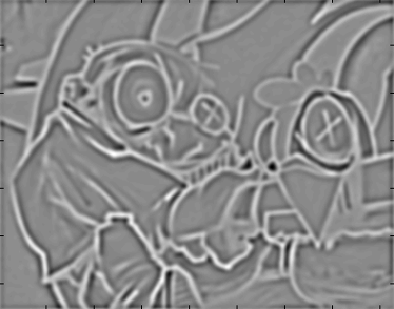
Review: Find local maxima in position-scale space of Difference-of-Gaussian
σ⁵
σ⁴
σ³
σ²
⇒ List of (x, y, s)
σ

Slide 7
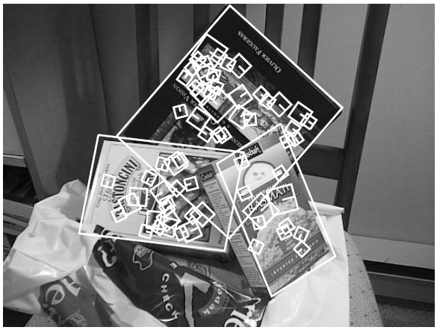
Review: SIFT Descriptor
Histogram of oriented gradients
Captures important texture information
Robust to small translations / affine deformations
[Lowe, ICCV 1999]
K. Grauman, B. Leibe

Slide 8
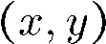
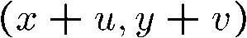
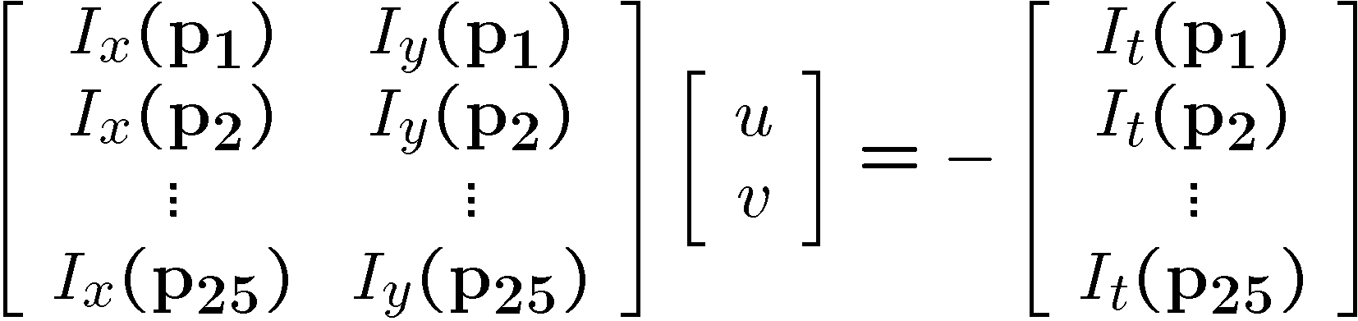
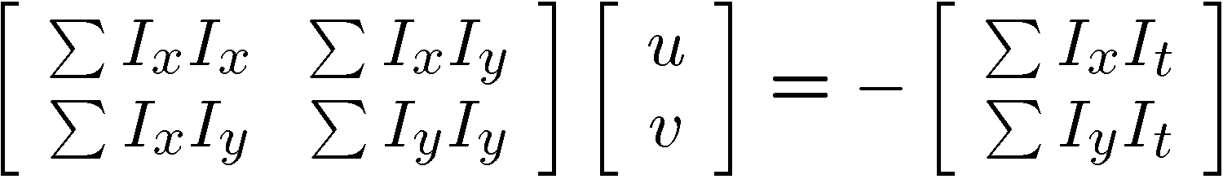
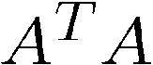
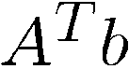
Review: Lucas-Kanade Tracker
I(x,y,t)
I(x,y,t+1)
Brightness consistency
Small motion
Spatial coherence

Slide 9
Dealing with larger movements: Iterative refinement
Original (x,y) position
I_{t} = I(x’, y’, t+1) - I(x, y, t)
Initialize (x’,y’) = (x,y)
Compute (u,v) by
Shift window by (u, v): x’=x’+u; y’=y’+v;
Recalculate I_{t}
Repeat steps 2-4 until small change
Use interpolation for subpixel values
2nd moment matrix for feature patch in first image
displacement

Slide 10
Dealing with larger movements: coarse-to-fine registration
run iterative L-K
upsample
run iterative L-K
.
.
.
image J
image I
image 1
image 2
Gaussian pyramid of image 1 (t)
Gaussian pyramid of image 2 (t+1)

Slide 11
Fitting [ˈfidiNG]:
find the parameters of a model that best fit the data
Alignment [əˈlīnmənt]:
find the parameters of the transformation that best align matched points

Slide 12
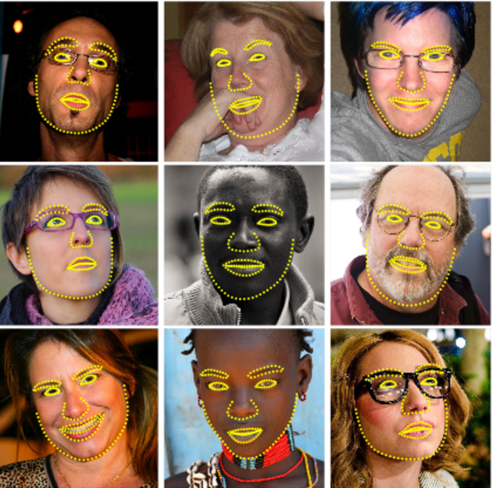
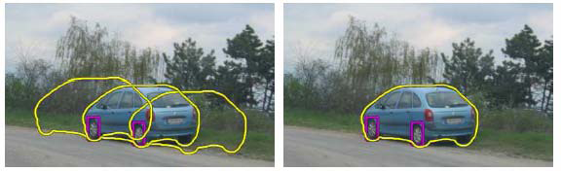
Fitting and alignment
Choose a parametric model to represent a set of features
simple model: lines
simple model: circles
complicated model: face shape
complicated model: car
Source: K. Grauman

Slide 13
Fitting and Alignment -Design challenges
Design a suitable goodness of fit measure
Similarity should reflect application goals
Encode robustness to outliers and noise
Design an optimization method
Avoid local optima
Find best parameters quickly

Slide 14
Fitting and Alignment: Methods
Global optimization / Search for parameters
Least squares fit
Robust least squares
Iterative closest point (ICP)
Hypothesize and test
Generalized Hough transform
RANSAC

Slide 15
Simple example: Fitting a line

Slide 16
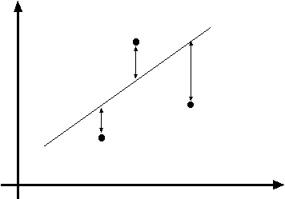
Least squares line fitting
Data: (x₁, y₁), …, (x_{n}, y_{n})
Line equation: y_{i} = m x_{i} + b
Find (m, b) to minimize
y=mx+b
(x_{i}, y_{i})
Matlab: p = A \ y;
Modified from S. Lazebnik

Slide 17
Problem with “vertical” least squares
Not rotation-invariant
Fails completely for vertical lines
Slide from S. Lazebnik

Slide 18
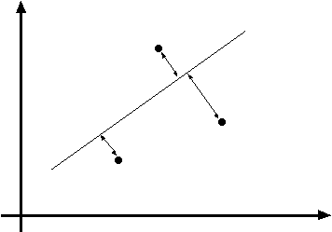
Total least squares
Slide modified from S. Lazebnik
If (a²+b²=1) then
Distance between point (x_{i}, y_{i}) and line ax+by+c=0 is |ax_{i} + by_{i} + c|
ax+by+c=0
Unit normal: N=(a, b)
(x_{i}, y_{i})
proof: http://mathworld.wolfram.com/Point-LineDistance2-Dimensional.html

Slide 19
Total least squares
Slide modified from S. Lazebnik
If (a²+b²=1) then
Distance between point (x_{i}, y_{i}) and line ax+by+c=0 is |ax_{i} + by_{i} + c|
Find (a, b, c) to minimize the sum of squared perpendicular distances
ax+by+c=0
Unit normal: N=(a, b)
(x_{i}, y_{i})

Slide 20
Total least squares
Slide modified from S. Lazebnik
Find (a, b, c) to minimize the sum of squared perpendicular distances
ax+by+c=0
Unit normal: N=(a, b)
(x_{i}, y_{i})
Solution is eigenvector corresponding to smallest eigenvalue of A^{T}A
See details on Raleigh Quotient: http://en.wikipedia.org/wiki/Rayleigh_quotient

Slide 21
Recap: Two Common Optimization Problems
Problem statement
Solution
(matlab)
Problem statement
Solution

Slide 22
Least squares (global) optimization
Good
Clearly specified objective
Optimization is easy
Bad
May not be what you want to optimize
Sensitive to outliers
Bad matches, extra points
Doesn’t allow you to get multiple good fits
Detecting multiple objects, lines, etc.

Slide 23
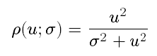
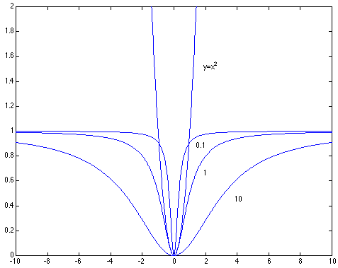
Robust least squares (to deal with outliers)
General approach:
minimize
u_{i} (x_{i}, θ) – residual of i^{th} point w.r.t. model parameters θ ρ – robust function with scale parameter σ
The robust function ρ
Favors a configuration
with small residuals
Constant penalty for large residuals
Slide from S. Savarese

Slide 24
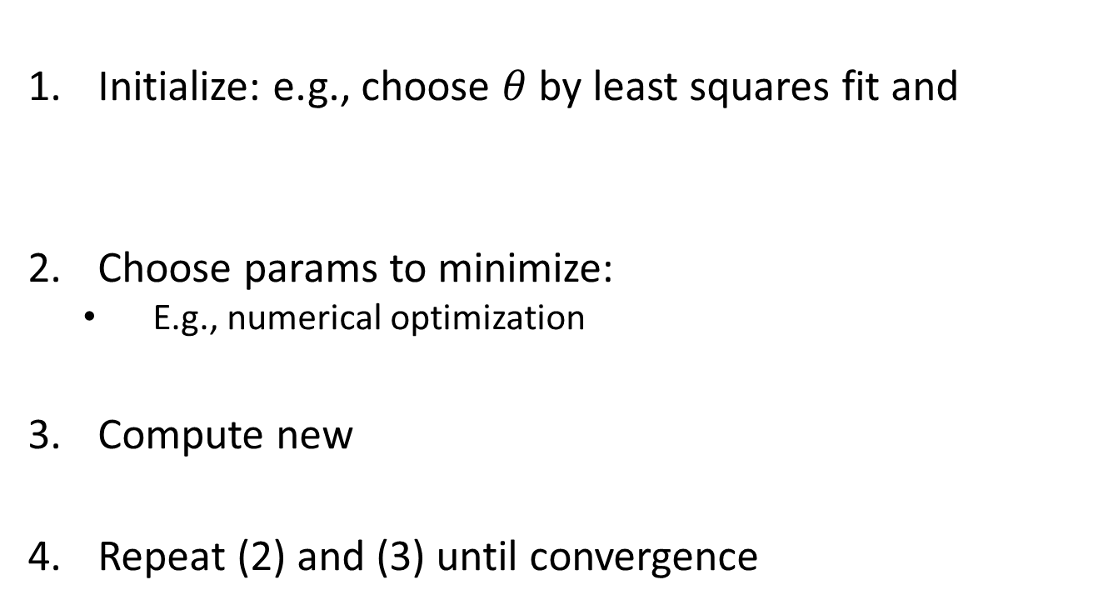
Robust Estimator
Initialize: e.g., choose $θ$ by least squares fit and
Choose params to minimize:
E.g., numerical optimization
Compute new
Repeat (2) and (3) until convergence

Slide 25
Other ways to search for parameters (for when no closed form solution exists)
Line search
For each parameter, step through values and choose value that gives best fit
Repeat (1) until no parameter changes
Grid search
Propose several sets of parameters, evenly sampled in the joint set
Choose best (or top few) and sample joint parameters around the current best; repeat
Gradient descent
Provide initial position (e.g., random)
Locally search for better parameters by following gradient

Slide 26
Hypothesize and test
Propose parameters
Try all possible
Each point votes for all consistent parameters
Repeatedly sample enough points to solve for parameters
Score the given parameters
Number of consistent points, possibly weighted by distance
Choose from among the set of parameters
Global or local maximum of scores
Possibly refine parameters using inliers

Slide 27
Hough Transform: Outline
Create a grid of parameter values
Each point votes for a set of parameters, incrementing those values in grid
Find maximum or local maxima in grid

Slide 28
Hough transform
P.V.C. Hough, Machine Analysis of Bubble Chamber Pictures, Proc. Int. Conf. High Energy Accelerators and Instrumentation, 1959
Given a set of points, find the curve or line that explains the data points best
y
m
x
b
Hough space
y = m x + b
Slide from S. Savarese
Notes:
􀁑 Basic ideas
• A line is represented as . Every line in the image corresponds
to a point in the parameter space
• Every point in the image domain corresponds to a line in the parameter
space (why ? Fix (x,y), (m,n) can change on the line . In other
words, for all the lines passing through (x,y) in the image space, their
parameters form a line in the parameter space)
• Points along a line in the space correspond to lines passing through the
same point in the parameter space (why ?)

Slide 29
Hough transform
y
m
x
b
y
m
3
5
3
3
2
2
3
7
11
10
4
3
2
3
1
4
5
2
2
1
0
1
3
3
x
b
Slide from S. Savarese
Notes:
􀁑 Basic ideas
• A line is represented as . Every line in the image corresponds
to a point in the parameter space
• Every point in the image domain corresponds to a line in the parameter
space (why ? Fix (x,y), (m,n) can change on the line . In other
words, for all the lines passing through (x,y) in the image space, their
parameters form a line in the parameter space)
• Points along a line in the space correspond to lines passing through the
same point in the parameter space (why ?)

Slide 30
Hough transform
P.V.C. Hough, Machine Analysis of Bubble Chamber Pictures, Proc. Int. Conf. High Energy Accelerators and Instrumentation, 1959
Issue : parameter space [m,b] is unbounded…
Use a polar representation for the parameter space
y
x
Hough space
Slide from S. Savarese
Notes:
􀁑 Basic ideas
• A line is represented as . Every line in the image corresponds
to a point in the parameter space
• Every point in the image domain corresponds to a line in the parameter
space (why ? Fix (x,y), (m,n) can change on the line . In other
words, for all the lines passing through (x,y) in the image space, their
parameters form a line in the parameter space)
• Points along a line in the space correspond to lines passing through the
same point in the parameter space (why ?)

Slide 31
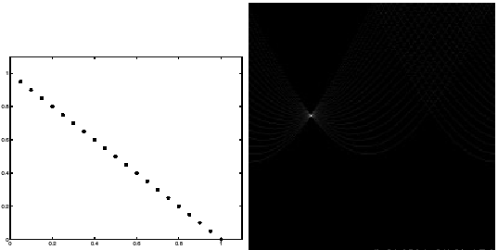
Hough transform - experiments
features
votes
Slide from S. Savarese
Notes:
Figure 15.1, top half. Note that most points in the vote array are very dark, because they
get only one vote.

Slide 32
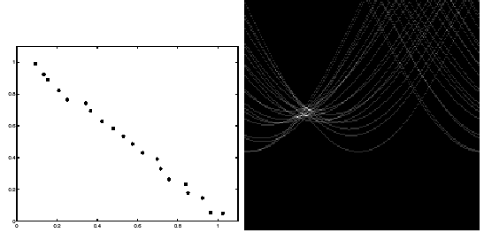
Hough transform - experiments
Noisy data
features
votes
Need to adjust grid size or smooth
Slide from S. Savarese
Notes:
This is 15.1 lower half

Slide 33
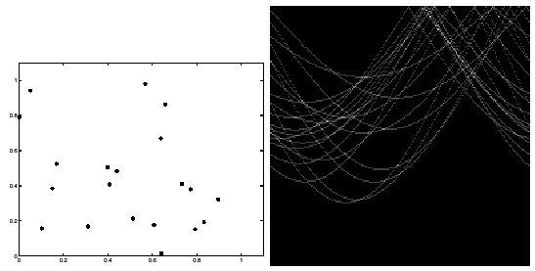
Hough transform - experiments
features
votes
Issue: spurious peaks due to uniform noise
Slide from S. Savarese
Notes:
15.2; main point is that lots of noise can lead to large peaks in the array

Slide 34
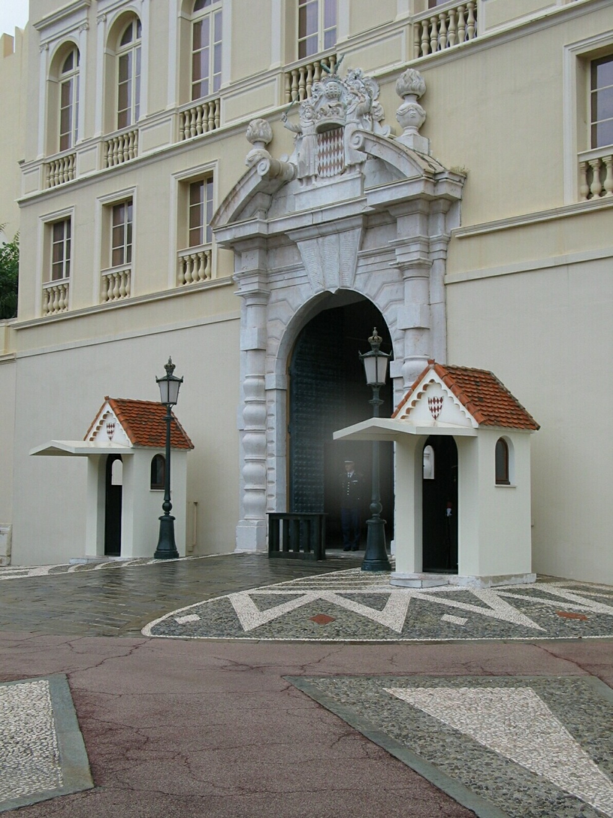
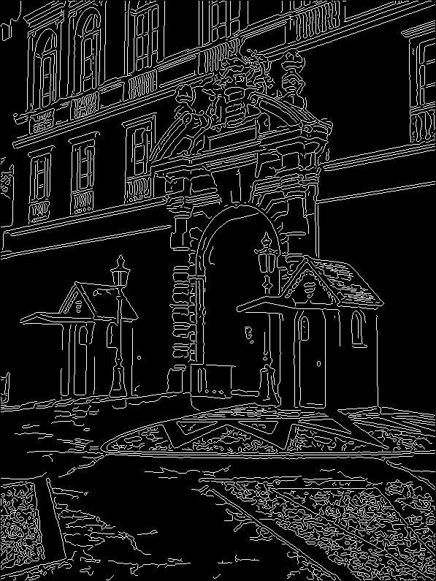
1. Image → Canny

Slide 35
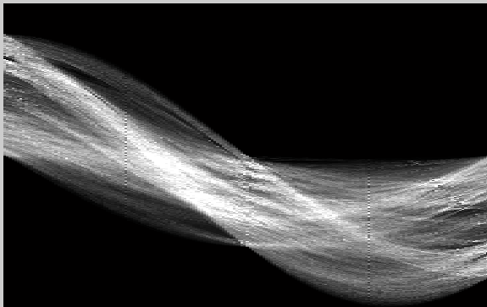
2. Canny → Hough votes

Slide 36
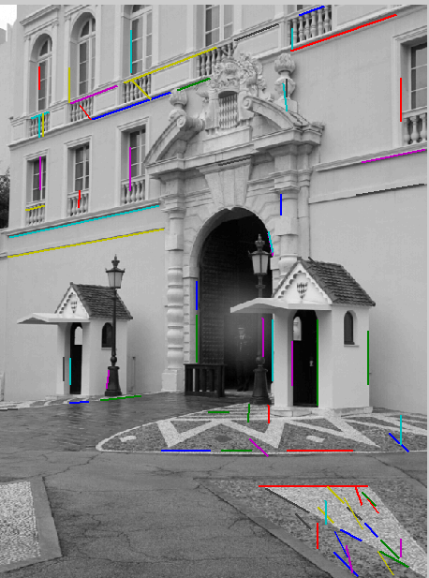
3. Hough votes → Edges
Find peaks and post-process

Slide 37
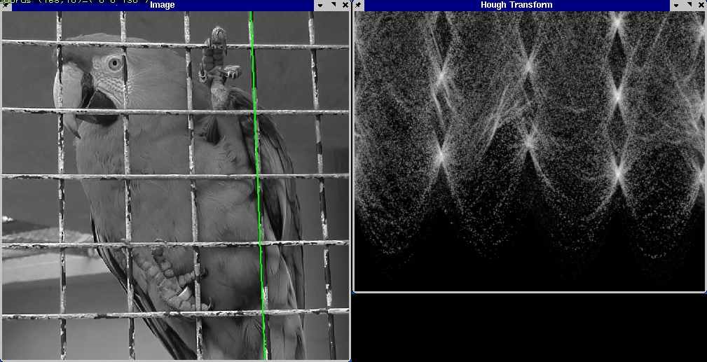
Hough transform example
http://ostatic.com/files/images/ss_hough.jpg

Slide 38
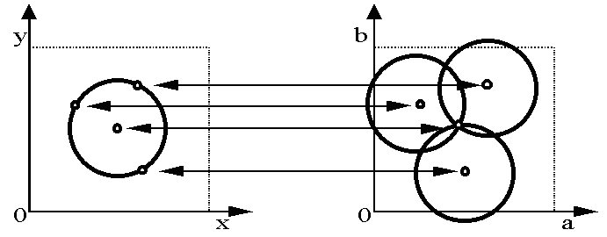
Hough transform for circles
Circle: center (a,b) and radius r
Equation of circle?
For a fixed radius r
Equation of set of circles that all pass through a point?
Image space
Hough space
Adapted by Devi Parikh from: Kristen Grauman

Slide 39
Hough transform for circles
Circle: center (a,b) and radius r
For a fixed radius r
Intersection: most votes for center occur here.
Image space
Hough space
Kristen Grauman

Slide 40
Hough transform for circles
Circle: center (a,b) and radius r
For an unknown radius r
r
?
b
a
Image space
Hough space
Kristen Grauman

Slide 41
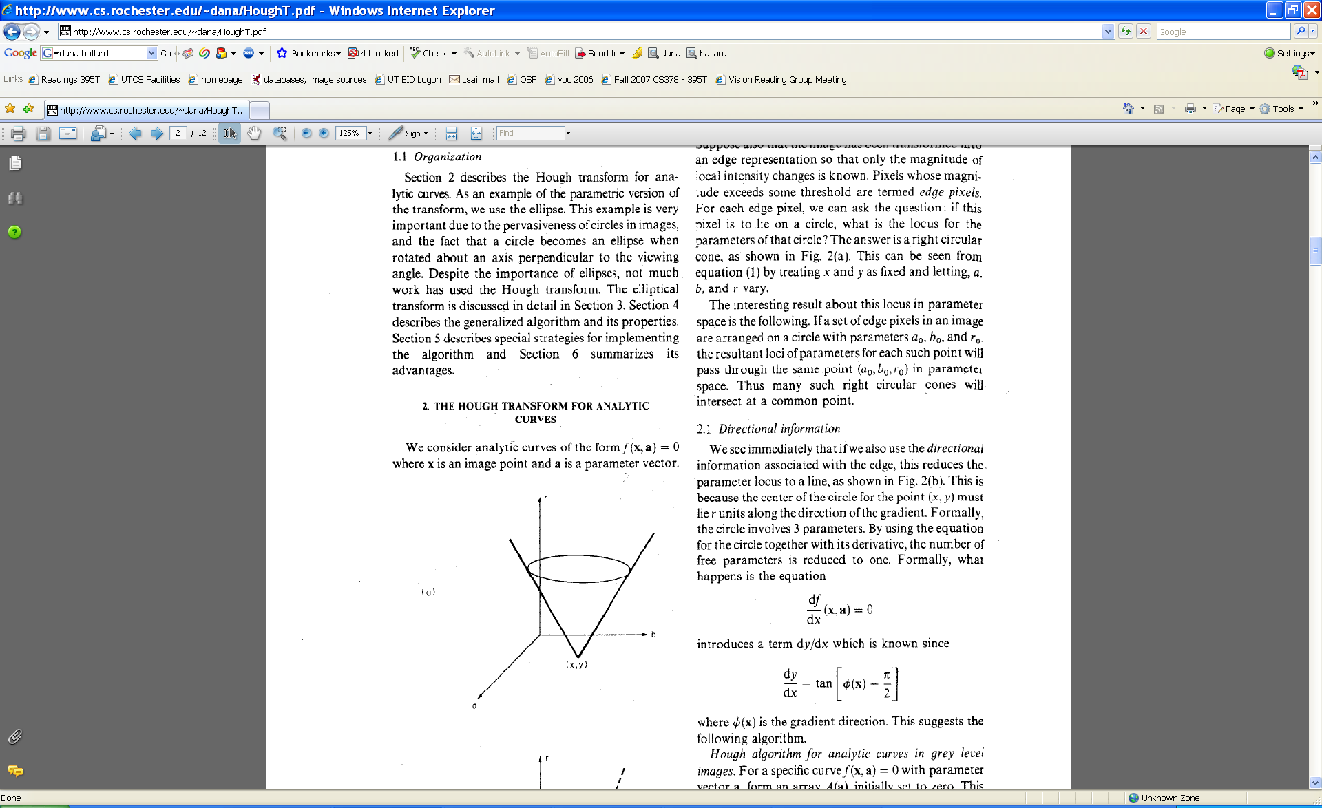
Hough transform for circles
Circle: center (a,b) and radius r
For an unknown radius r
r
b
a
Image space
Hough space
Kristen Grauman

Slide 42
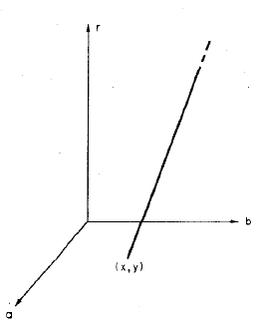
Hough transform for circles
Circle: center (a,b) and radius r
For an unknown radius r, known gradient direction
x
θ
Image space
Hough space
Kristen Grauman

Slide 43
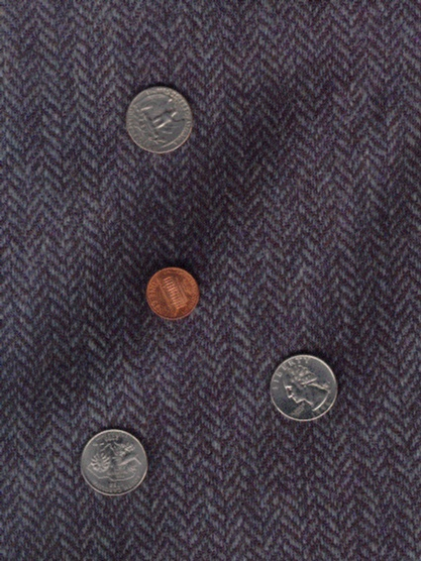


Example: detecting circles with Hough
Original
Edges
Votes: Penny
Note: a different Hough transform (with separate accumulators) was used for each circle radius (quarters vs. penny).
Slide credit: Kristen Grauman

Slide 44

Example: detecting circles with Hough
Original
Combined detections
Edges
Votes: Quarter
Slide credit: Kristen Grauman
Coin finding sample images from: Vivek Kwatra

Slide 45

Generalized Hough for object detection
Instead of indexing displacements by gradient orientation, index by matched local patterns.
“visual codeword” with displacement vectors
training image
B. Leibe, A. Leonardis, and B. Schiele, Combined Object Categorization and Segmentation with an Implicit Shape Model, ECCV Workshop on Statistical Learning in Computer Vision 2004
Source: L. Lazebnik

Slide 46

Generalized Hough for object detection
Instead of indexing displacements by gradient orientation, index by “visual codeword”
test image
B. Leibe, A. Leonardis, and B. Schiele, Combined Object Categorization and Segmentation with an Implicit Shape Model, ECCV Workshop on Statistical Learning in Computer Vision 2004
Source: L. Lazebnik

Slide 47
Hough transform conclusions
Good
Robust to outliers: each point votes separately
Fairly efficient (much faster than trying all sets of parameters)
Provides multiple good fits
Bad
Some sensitivity to noise
Bin size trades off between noise tolerance, precision, and speed/memory
Can be hard to find sweet spot
Not suitable for more than a few parameters
grid size grows exponentially
Common applications
Line fitting (also circles, ellipses, etc.)
Object instance recognition (parameters are position/scale/orientation)
Object category recognition (parameters are position/scale)

Slide 48
Two-mins break

Slide 49
RANSAC
_{(RANdom SAmple Consensus) :}
Fischler & Bolles in ‘81.
Algorithm:
Sample (randomly) the number of points required to fit the model
Solve for model parameters using samples
Score by the fraction of inliers within a preset threshold of the model
Repeat 1-3 until the best model is found with high confidence
Notes:
Let me give you an intuition of what is going on. Suppose we have the standard line fitting problem in presence of outliers.
We can formulate this problem as follows: want to find the best partition of points in inlier set and outlier set such that…
The objective consists of adjusting the parameters of a model function so as to best fit a data set.
"best" is defined by a function f that needs to be minimized.
Such that the best parameter of fitting the line give rise to a residual error lower that delta
as when the sum, S, of squared residuals

Slide 50
RANSAC
Line fitting example
Algorithm:
Sample (randomly) the number of points required to fit the model (#=2)
Solve for model parameters using samples
Score by the fraction of inliers within a preset threshold of the model
Repeat 1-3 until the best model is found with high confidence
Illustration by Savarese
Notes:
Let me give you an intuition of what is going on. Suppose we have the standard line fitting problem in presence of outliers.
We can formulate this problem as follows: want to find the best partition of points in inlier set and outlier set such that…
The objective consists of adjusting the parameters of a model function so as to best fit a data set.
"best" is defined by a function f that needs to be minimized.
Such that the best parameter of fitting the line give rise to a residual error lower that delta
as when the sum, S, of squared residuals

Slide 51
RANSAC
Line fitting example
Algorithm:
Sample (randomly) the number of points required to fit the model (#=2)
Solve for model parameters using samples
Score by the fraction of inliers within a preset threshold of the model
Repeat 1-3 until the best model is found with high confidence
Notes:
Let me give you an intuition of what is going on. Suppose we have the standard line fitting problem in presence of outliers.
We can formulate this problem as follows: want to find the best partition of points in inlier set and outlier set such that…
The objective consists of adjusting the parameters of a model function so as to best fit a data set.
"best" is defined by a function f that needs to be minimized.
Such that the best parameter of fitting the line give rise to a residual error lower that delta
as when the sum, S, of squared residuals

Slide 52
RANSAC
Line fitting example
Algorithm:
Sample (randomly) the number of points required to fit the model (#=2)
Solve for model parameters using samples
Score by the fraction of inliers within a preset threshold of the model
Repeat 1-3 until the best model is found with high confidence
Notes:
Let me give you an intuition of what is going on. Suppose we have the standard line fitting problem in presence of outliers.
We can formulate this problem as follows: want to find the best partition of points in inlier set and outlier set such that…
The objective consists of adjusting the parameters of a model function so as to best fit a data set.
"best" is defined by a function f that needs to be minimized.
Such that the best parameter of fitting the line give rise to a residual error lower that delta
as when the sum, S, of squared residuals

Slide 53
RANSAC
Algorithm:
Sample (randomly) the number of points required to fit the model (#=2)
Solve for model parameters using samples
Score by the fraction of inliers within a preset threshold of the model
Repeat 1-3 until the best model is found with high confidence
Notes:
Let me give you an intuition of what is going on. Suppose we have the standard line fitting problem in presence of outliers.
We can formulate this problem as follows: want to find the best partition of points in inlier set and outlier set such that…
The objective consists of adjusting the parameters of a model function so as to best fit a data set.
"best" is defined by a function f that needs to be minimized.
Such that the best parameter of fitting the line give rise to a residual error lower that delta
as when the sum, S, of squared residuals

Slide 54
How to choose parameters?
Number of samples N
Choose N so that, with probability p, at least one random sample is free from outliers (e.g. p=0.99) (outlier ratio: e )
Number of sampled points s
Minimum number needed to fit the model
Distance threshold δ
Choose δ so that a good point with noise is likely (e.g., prob=0.95) within threshold
Zero-mean Gaussian noise with std. dev. σ: t²=3.84σ²
 | proportion of outliers e
s | 5% | 10% | 20% | 25% | 30% | 40% | 50%
2 | 2 | 3 | 5 | 6 | 7 | 11 | 17
3 | 3 | 4 | 7 | 9 | 11 | 19 | 35
4 | 3 | 5 | 9 | 13 | 17 | 34 | 72
5 | 4 | 6 | 12 | 17 | 26 | 57 | 146
6 | 4 | 7 | 16 | 24 | 37 | 97 | 293
7 | 4 | 8 | 20 | 33 | 54 | 163 | 588
8 | 5 | 9 | 26 | 44 | 78 | 272 | 1177
modified from M. Pollefeys

Slide 55
RANSAC conclusions
Good
Robust to outliers
Applicable for larger number of objective function parameters than Hough transform
Optimization parameters are easier to choose than Hough transform
Bad
Computational time grows quickly with fraction of outliers and number of parameters
Not as good for getting multiple fits (though one solution is to remove inliers after each fit and repeat)
Common applications
Computing a homography (e.g., image stitching)
Estimating fundamental matrix (relating two views)

Slide 56

RANSAC Song

Slide 57
Demo Line Fitting

Slide 58


What if you want to align but have no prior matched pairs?
Hough transform and RANSAC not applicable
Important applications
Medical imaging: match brain scans or contours
Robotics: match point clouds

Slide 59
Iterative Closest Points (ICP) Algorithm
Goal: estimate transform between two dense sets of points
Initialize transformation (e.g., compute difference in means and scale)
Assign each point in {Set 1} to its nearest neighbor in {Set 2}
Estimate transformation parameters
e.g., least squares or robust least squares
Transform the points in {Set 1} using estimated parameters
Repeat steps 2-4 until change is very small

Slide 60

Example: solving for translation
A₁
A₂
A₃
B₁
B₂
B₃
Given matched points in {A} and {B}, estimate the translation of the object

Slide 61
Example: solving for translation
A₁
A₂
A₃
(t_{x}, t_{y})
B₁
B₂
B₃
Least squares solution
Write down objective function
Derived solution
Compute derivative
Compute solution
Computational solution
Write in form Ax=b
Solve using pseudo-inverse or eigenvalue decomposition

Slide 62
Example: solving for translation
A₁
A₅
B₄
A₂
A₃
(t_{x}, t_{y})
B₁
A₄
B₂
B₃
B₅
Problem: outliers
RANSAC solution
Sample a set of matching points (1 pair)
Solve for transformation parameters
Score parameters with number of inliers
Repeat steps 1-3 N times

Slide 63
Example: solving for translation
B₄
A₁
B₅
B₆
A₂
A₃
(t_{x}, t_{y})
B₁
A₄
B₂
B₃
A₅
A₆
Problem: outliers, multiple objects, and/or many-to-one matches
Hough transform solution
Initialize a grid of parameter values
Each matched pair casts a vote for consistent values
Find the parameters with the most votes
Solve using least squares with inliers

Slide 64
Example: solving for translation
(t_{x}, t_{y})
Problem: no initial guesses for correspondence
ICP solution
Find nearest neighbors for each point
Compute transform using matches
Move points using transform
Repeat steps 1-3 until convergence

Slide 65
Things to remember
Least Squares Fit
closed form solution
robust to noise
not robust to outliers
Robust Least Squares
improves robustness to noise
requires iterative optimization
Hough transform
robust to noise and outliers
can fit multiple models
only works for a few parameters (1-4 typically)
RANSAC
robust to noise and outliers
works with a moderate number of parameters (e.g, 1-8)
Iterative Closest Point (ICP)
For local alignment only: does not require initial correspondences

Slide 66
Next week
Object instance recognition

